Slide 1
Example single cell RNA-sequencing data analysis

Slide 2
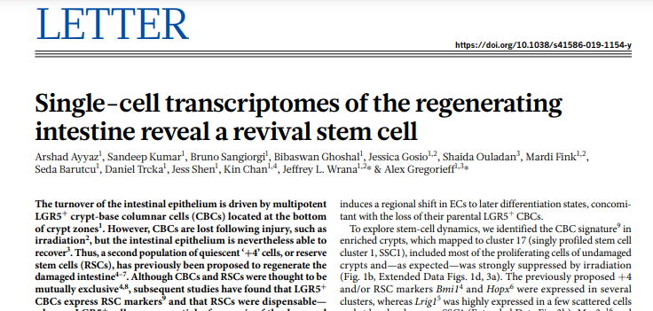
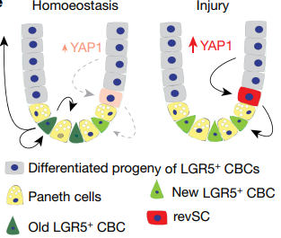
Similar to the EMI project (identifying a new cell population)
Similar pipeline that we might used (10x)

Slide 3
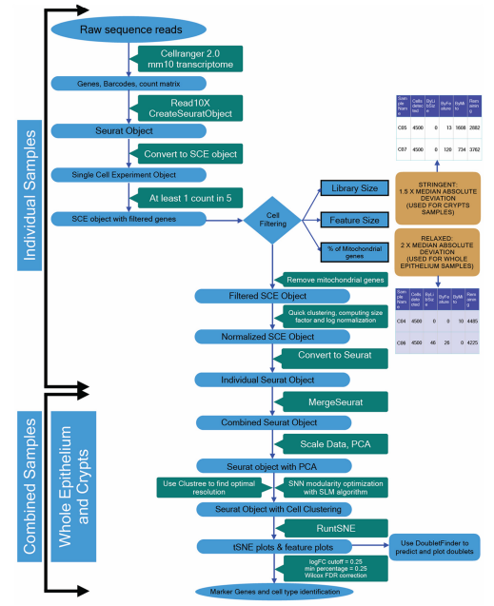
Data analysis pipeline
Following the pipeline that paper proposed.
Raw reads -> count matrix (cellranger)
Downstream: filter, normalized, merge, scale, PCA, tSNE & markers (Seurat, single cell experiment objects)

Slide 4
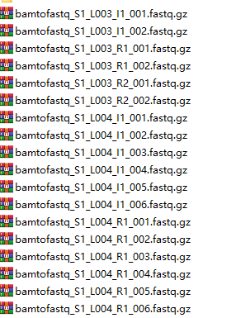

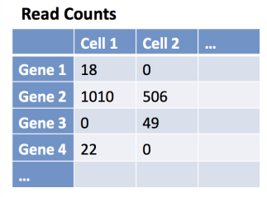
Raw reads -> count matrix

Slide 5
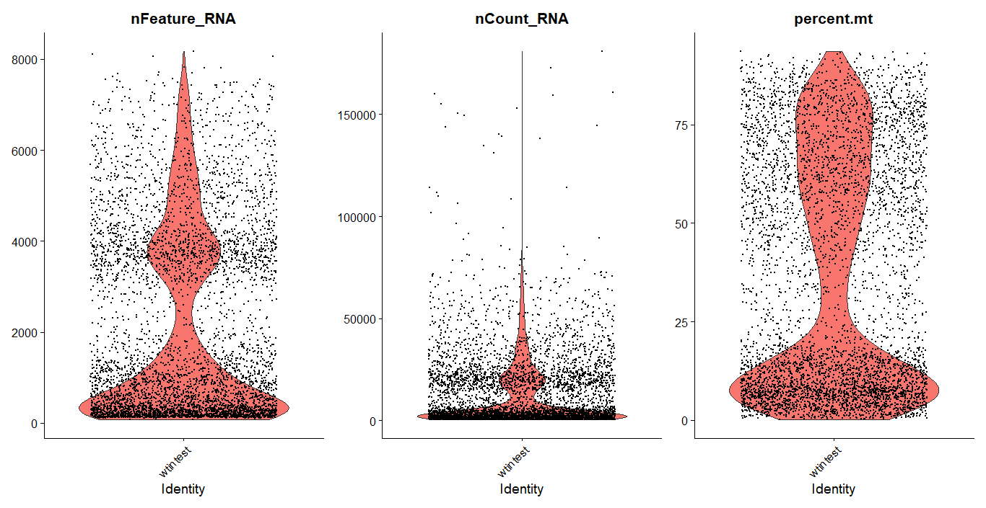
Overall data quality-wild type crypt

Slide 6
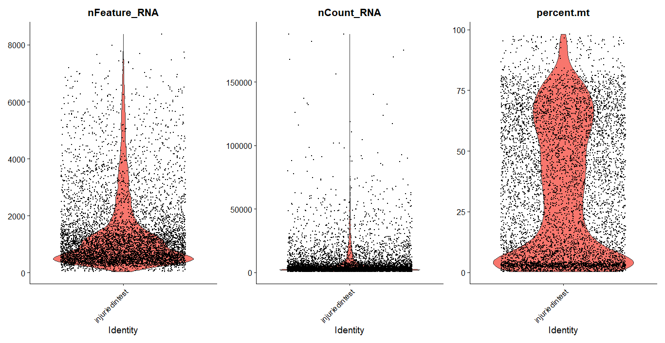
Overall data quality-irradiated crypt

Slide 7
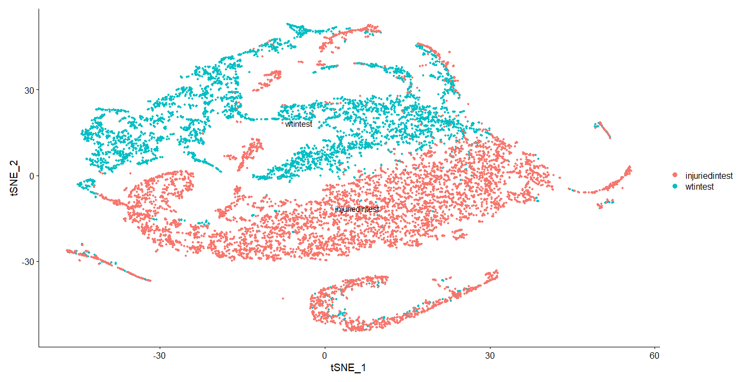
Enriched crypt-normal irradiated merged: my analysis

Slide 8
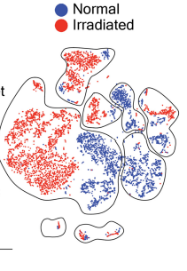
Comparison of paper analysis and my analysis
May be the RevSC population??

Slide 9
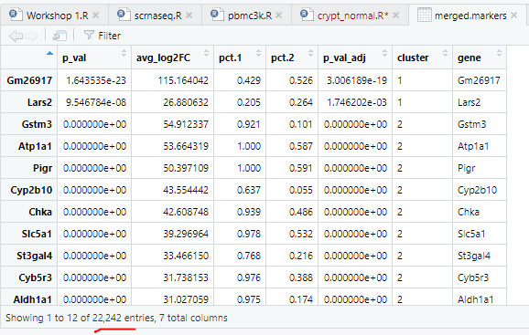
Current problems of scRNA-seq analysis
Cells are not well clustered → Some unknown parameters (not sure how they filter the cells and features, very undetailed documentation in paper)
Too many markers identified → not sure the exact reasons of high false positive rate

Slide 10
Code availability
QichenFU/SRTP_EMI (github.com)

